Slide 1
CSCI 3907/CSCI 6444: Big Data and Analytics
Summer 2021
Stephen H. Kaisler, D.Sc.
Lecture 4 – Text Analytics
Notes:
Text Analytics is one of the “Big Three” in Analytic problems in my view.

Slide 2
Definition: Text Analytics
The analysis of structured and unstructured text to obtain and organize information:
  The extraction of information from structured and unstructured text.
  The resolution of entities
  Co-reference analysis of pronouns and nouns
  Mapping of information to ontological structures
  Synthesize the content in a knowledge structure
  Understand the content to generate actionable intelligence
  Uncover patterns in themes and texts
A loosely organized set of competing technologies
One unifying theme behind these technologies is the concept of “turning text into numbers” so that quantitative methods can be applied to extract information.
But, that is not all there is to text analytics!
CSCI 3907/CSCI 6444: Big Data and Analytics
Notes:
Text Analytics differs from graph analytics and quantitative analytics in several ways:
- Text analytics focuses largely on qualitative and conceptual information rather than numerical information.
To use textual data for quantitative analysis, we must first encode the text into numbers. This requires a “code back” which maps pieces of text to specific numbers – usually integers. Constructing a code book is an art that is very domain dependent.
Data to be used in graph analytics is often represented as text, but the relationships between objects/entities may not be explicit. Usually, there are many relationships and we must reduce the number to have tractable problem.

Slide 3
Why Text Analytics?
The explosion of user-generated content in the social media has greatly increased the need for automated means to extract data about events, people, things, etc.
  90% of all the data in the world we have created in the last 24 months — averaging 2.5 quintillion bytes per day — and about 90% of that is unstructured data (Griffith 2018)
“Take the pulse of the marketplace or society in general”
Understand the relationships between people by analyzing, e.g., twitter feeds and other textual media.
Mine data from technical articles
Provide data for document summarization
  Remember Reader’s Digest?
CSCI-3907/CSCI-6444 Big Data and Analytics
7-<number>
Notes:
We’ve noted that roughly 80-85% of human knowledge still resides in paper or textual form – even if it has been digitized.
Since so much is reported in text – whether on social media, in news broadcasts, on Twitter or Facebook, text analytics can allow us to sense trends in many different areas.
Consider the Million Letter Project which focuses on preserving the letters of servicemen written during World War II to their families and friends. Preservation of these will provide an essential understanding of culture, people, and events during this period that is irreplaceable.
Mining data from technical articles and papers will make it more easily available to future researchers.
“Good ideas come around again and again – just in different packaging”

Slide 4
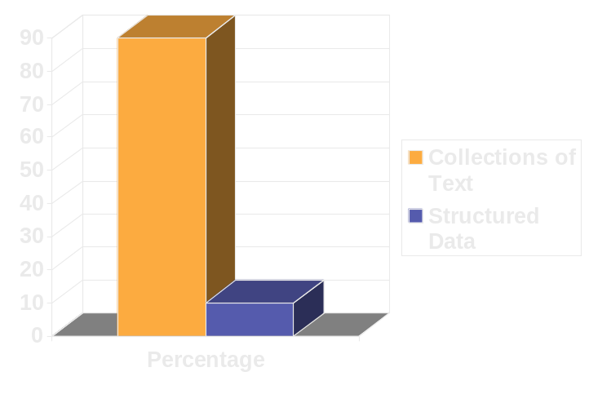
Text Mining
Text Mining is a subset of Text Analytics that is used for:
  Content and document management
  Information search and retrieval
  Processing XML/RDF databases
  Categorization, classification, and visualization
Has been around since late 1880s (see Luellen 2019)
As a reminder, it has been estimated that 80+% of the information in an organization is represented as unstructured text.
But, it does not provide correct results in every case.
CSCI 3907/CSCI 6444: Big Data and Analytics
Notes:
Thomas Mendenhall, a physics professor at Ohio State and Tokyo University, used statistical methods to analyze curves of composition characteristics in a paper published in the journal Science in March of 1887
Mendenhall, T. (1887). The characteristic curves of composition. Science, 9(214S): 237–246.
Claude Brinegar analyzed the writings of Quintus Curtius Snodgrass in March of 1963 in the American Statistical Association Journal to prove it was a pseudonym for Mark Twain, itself a pseudonym for Samuel L. Clemens (Brinegar, 1963)
Brinegar, C. (1963). Mark Twain and the Quintus Curtius Snodgrass letters: A statistical test of authorship. Journal of the American Statistical Association, 58(301): 85–96.
Frederick Mosteller of Harvard University and David Wallace of the University of Chicago used the statistical model of Naïve Bayes with Poisson and negative binomials in June 1963 to analyze which of the US founding fathers, Alexander Hamilton or James Madison, wrote passages of the Federalist Papers (Mosteller, 1963)
Mosteller, F., Wallace, D. (1963). Inference in an authorship problem. Journal of the American Statistical Association, 275–309.

Slide 5
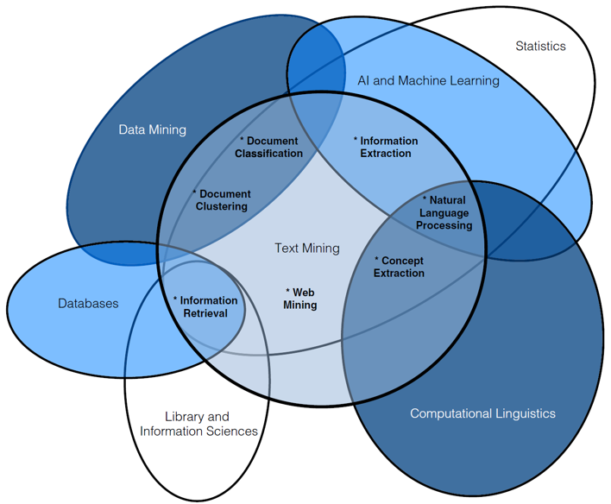
Where does it fit?
CSCI-3907/CSCI-6444 Big Data and Analytics
7-<number>
Notes:
Text Mining and Text Analytics are at the intersection of multiple analytic disciplines.
A key research problem is determining how all of these disciplines interact in order to extract data and information.
For example, what happens if two disciplines generate conflicting information – how will we resolve the disparities?
How do we merge data/information from two or more different sources using different methods? This is a great MS or PhD topic.

Slide 6
Basic Idea - I
Text is meant to be read by humans, not machines.
Much useful information is stored as text
  Think of all the libraries and their books and papers
  100’s of times more on-line text than on-line databases
  Web pages are text files with structure tags (HTML)
General Natural Language Understanding is still too hard
  But, General Natural Language Processing (NLP) has had some successes
  We will discuss NLP during Lecture 9.
Key Questions:
  What data can we extract from text to describe, diagnose, predict or prescribe?
  What transformations should we apply to extracted data to organize it?
CSCI-3907/CSCI-6444 Big Data and Analytics
Notes:
Bullet 1 is key:
What does it mean to make text readable/understandable by machines?
Well, when we started to talk about Web 3.0 and how we were going to annotate everything with XML, this seemed to be a good idea.
But, it hasn’t happened yet, has not been automated, and is not likely to happen in the next 25 years.
However, quoting Arthur C. Clarke, famous Science Fiction Writer:
“When a senior scientist something is surely possibly, s/he is usually right; but, when they say something is not possible, they are almost certainly wrong!

Slide 7
Terminology-I
Document is a sentence or composed of sentences.
Tokens represent words. E,g., “men”, “liberty”, …
Terms represent single words or multiple words as units/phrases, e.g., “civil war”.
Corpus is a collection of documents.
Stopwords are basically a set of commonly used words which you want to exclude while analyzing text. Examples of stopwords - 'a', 'an', 'the', 'to', 'of', 'ABC Company' etc.
Document Term Matrix is a matrix consisting of documents in a row and terms in columns.
Sparse term: Terms occurring only in very few documents (Sentences).
Tokenization is the process of splitting unstructured data into tokens such as words, phrases, sentences, but mostly words.
CSCI-3907/CSCI-6444 Big Data and Analytics
7-<number>

Slide 8
Terminology-II
Stemming: Extracting the core word from its variants, such as "interesting", "interest" and "interested" are all stemmed to "interest".
Polarity: Whether a document or sentence is positive, negative or neutral - commonly used in sentiment analysis.
Bag-of-words: Each sentence (or document) is a bag of words ignoring grammar and even word order.
Part of Speech Tagging: Involves tagging/assigning every word in the document a part of speech - noun, verb, adjective, pronoun, single noun, plural noun, etc.
  Note: This is very difficult since the POS may depend on the context in which the word is used.
  Consider the word “like” and how it may be used in a sentence.
Term Frequency - Inverse Document Frequency (tf-idf):
  Measures how important a word is based on its frequency of occurrence:
  TF(t) = (Number of times term t appears) / (Total number of terms)
CSCI-3907/CSCI-6444 Big Data and Analytics
7-<number>

Slide 9
Terminology-III
Inverse Document Frequency measures how important a word is.
  If a word appears frequently in a document, then it should be important and we should give that word a high score.
  But if a word appears in too many other documents, it’s probably not a unique identifier, therefore we should assign a lower score to that word.
  IDF(t) = log to base e(Total number of documents / Number of documents containing term t)
Term Frequency Inverse Document Frequency:
tf-idf = tf × idf
Ex: Suppose a word 'good' appears 373 times in total 6 documents which contains in total 122204 words (terms).
  Term Frequency (TF) would be 0.00305 i.e. =373/122204.
  But this word appears in only 1 document so IDF would be ln(6/1) = 1.791759.
  Hence, tf-idf = TF * IDF = 0.0054.
CSCI-3907/CSCI-6444 Big Data and Analytics
7-<number>

Slide 10
Seven Practice Areas
Search and Information Retrieval: Storage and retrieval of text, including keyword search, phrase search, etc.
Document Clustering: Group and categorizing terms, phrases, paragraphs, documents using different techniques, including data mining
Document Classification: classification of documents and subcomponents using different techniques, including data mining
Web Mining: Applying (2) and (3) to text on the Web with an emphasis on interconnectedness
Information Extraction: Identification and extraction of relevant information from unstructured text
Natural Language Processing: language processing and understanding, including semantics
Concept Extraction: grouping of words and phrases into semantically similar groups to summarize content
CSCI-3907/CSCI-6444 Big Data and Analytics
Notes:
There are many different ways to divide text analytics. This is one that I happen to like.

Slide 11
The Building Blocks of Language
Morphology: Study of structure and form of words
Syntax: Study of how words and phrases form sentences
  Underlying this is the notion of formal grammars
Semantics: Study of meaning of words and statements
Phonology: Study of sounds in language (e.g., think homonyms)
Pragmatics: Study of idiomatic phrases that cannot be analyzed with strict semantic analysis
These form a discipline: Computational Linguistics
CSCI-3907/CSCI-6444 Big Data and Analytics
Notes:
Morphology is the study of words, how they are formed, and their relationship to other words in the same language. It analyzes the structure of words and parts of words, such as stems, root words, prefixes, and suffixes.
Syntax analyzes the structure of words and parts of words, such as stems, root words, prefixes, and suffixes.
Semantics is the linguistic and philosophical study of meaning in language, programming languages.
Phonology is a branch of linguistics concerned with the systematic organization of sounds in spoken languages and signs in sign languages.
Pragmatics: idioms, jargon, metaphors, acronyms, etc. (see Lakoff 1987)
Computational linguistics is an interdisciplinary field concerned with the statistical or rule-based modeling of natural language from a computational perspective, as well as the study of appropriate computational approaches to linguistic questions.

Slide 12
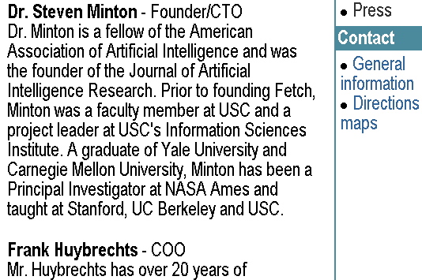
Text Analytics Landscape - I
Text paragraphs without formatting
  Unstructured text
  Ambiguous use of English (or other language)
  Partial sentences
  Bulleting and other punctuation issues
Grammatical Sentences w/ some formatting and linking
Astro Teller is the CEO and co-founder of BodyMedia. Astro holds a Ph.D. in Artificial Intelligence from Carnegie Mellon University, where he was inducted as a national Hertz fellow. His M.S. in symbolic and heuristic computation and B.S. in computer science are from Stanford University. His work in science, literature and business has appeared in international media from the New York Times to CNN to NPR.
CSCI-3907/CSCI-6444 Big Data and Analytics
TA-<number>
Notes:
These examples illustrate the difficulties of processing text.
In these examples we have sentences which must be parsed using rules of grammar to extract the relationships between the words.
Statistical techniques such as latent semantic analysis and dirichlet allocation just look at the frequencies of words and, sometimes, their proximity to other words.
The problem – in my mind – is that they ignore the syntax and semantics such as parts of speech and the meaning of words and phrases in context which provide additional information.
Both examples use acronyms for entities which we must have a dictionary to translate. Usually, we want to expand these to use for correlation purposes as we gather more information, including querying other sources.

Slide 13
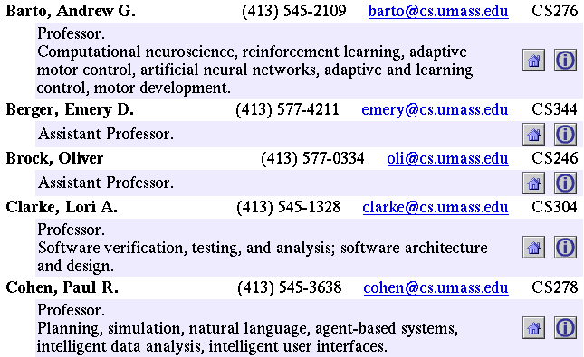
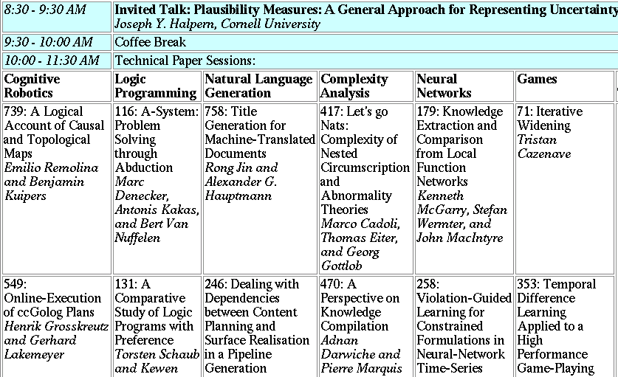
Text Analytics Landscape - II
Non-grammatical snippets w/ rich formatting and linking
  Directories
  Short biographies
Data Tables
  Cellular structure
  Organized by topic, category, class, etc.
  Phrases, not sentences
CSCI-3907/CSCI-6444 Big Data and Analytics
TA-<number>
Notes:
In these examples, the data is semistructured. Processing these often requires special programs to be developed to understand the structure in order to extract information.
Some knowledge of the domain and the structural semantics will help t extract relevant information.
Note that there are terms here, such as “Professor” which require external knowledge and ontologies.
For example, the fact the Professors work at colleges or universities. That there is a hierarchy of ranks for academics. Note also, we need to understand the structure of emails. And, we need information about conferences and agendas and topics of talks as depicted in the second example.
So, text analytics is not as easy as represented by statistical methods.

Slide 14
Text Analytics Examples
The following pages will demonstrate how to use some of the packages for Text Analytics.
SAT: Thirteen Essays from SAT Exams
Taken from published literature
Varying lengths: 1 to 5 paragraphs, multiple sentences
Multiple topics
Varying language complexity
CSCI-3907/CSCI-6444 Big Data and Analytics
7-<number>
Notes:
We are going to walk through how to use some of the R packages and their functions to begin to show you how to analyze text.
See also the document “Introduction to Text Analytics” posted with Class Project 3.

Slide 15

Create a VCorpus - I
Note: A VCorpus (volatile corpus) is kept entirely in memory.
It is a collection of documents containing natural language text using the infrastructure of the package tm.
Corpus is an S3 class from which VCorpus inherits. S3 is one of the formats used by R packages.
There are others, such as tibbles. Some of these are not interoperable and are not easily translated from one to the other.
CSCI-3907/CSCI-6444 Big Data and Analytics
7-<number>
Notes:
A VCorpus is a data structure that represents a set of documents.
We have several documents in this VCorpus.
Some of the methods that we examine will use the S3 structure. There are other structures, specifically tibbles, which are not conforomable to the S3 structure.

Slide 16
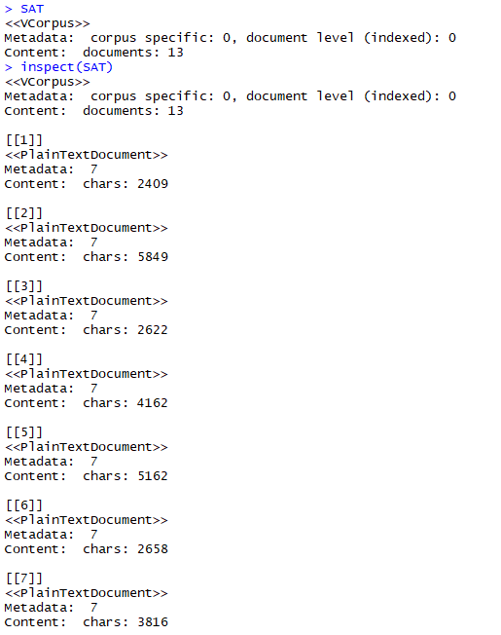
Create a VCorpus - II
Six more documents in the corpus
A mix of topics
For a single document, you can manually break it into chapters or sections, which each become a document in their own right.
Make each one a file within your directory.
When you create the corpus, you will see something like at right, except the components will be chapters
CSCI-3907/CSCI-6444 Big Data and Analytics
Notes:
The VCorpus is maintained in memory.
Changes to the VCorpus reside only in memory, unless you push them out to a file.
REMEMBER! Save your workspace frequently!!

Slide 17
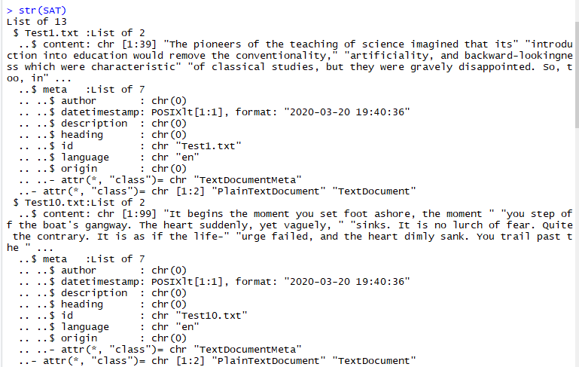
VCorpus Structure
Eleven more entries are printed out
CSCI-3907/CSCI-6444 Big Data and Analytics
7-<number>
Notes:
So, the Corpus has thirteen documents in it.
Each document has its own structure. We’ll examine this in the next slide.
Notice that the documents are arranged in lexicographic order when their structures are printed out, e.g., test1 followed by test10 followed by test11 and so forth.
Unless there is explicit metadata associated with the file, most of the structure will not be populated.

Slide 18
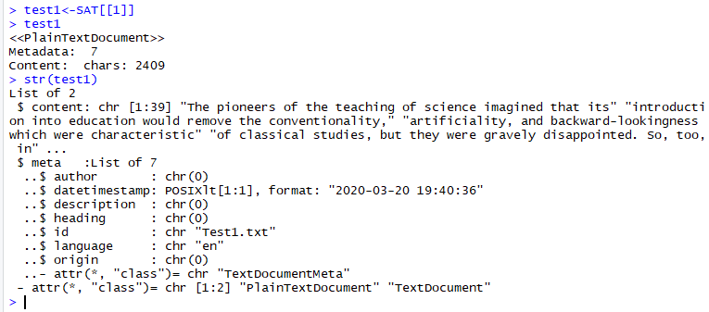
Extracting a Document
To extract a document from the corpus
CSCI-3907/CSCI-6444 Big Data and Analytics
7-<number>
Notes:
To extract a document, we index twice.
Why? Because the corpus is an array of documents. Test1 is the first document in that array, we use the form [[1]].
If we give a nonexistent index, we get an error:
SAT[[14]]
Error in x$content [[i]]:Subscript out of bounds
Test1 contains two attributes: content, which is the text which has 39 lines, and meta, which is descriptive info.
No author, description, heading or origin were associated with this document which I copied off of website have some practice SAT Reading Test paragraphs.
The datetime stamp tells when the structure was created: March 20, 2020.
The ”id” is the file name.

Slide 19
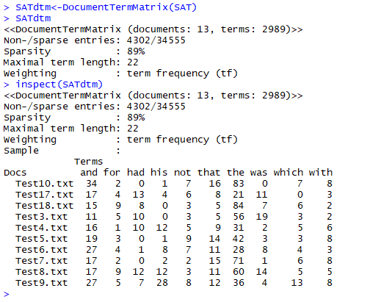
Document Term Matrix - I
Takes a corpus to process
and, optionally, some
control parameters.
Enter DocumentTermMatrix
into “Help in the lower right pane to see the documentation.
CSCI-3907/CSCI-6444 Big Data and Analytics
Notes:
The DocumentTermMatrix (DTM) maps documents to terms in the documents. It tells you how many occurrences of each term in each document. So, there are 34 occurrences of the word “and” in document test10.
Note not all words are displayed, just the first ten across.
The sparsity indicates that 89% of the words in the 13 documents occur only once. This is because these documents are about different topics. We would expect to see, if the set of documents were about a single topic, much less sparsity.
The longest term has a length of 22 characters. As we’ll see, this term might also include punctuation which we are going to eliminate as we do further analysis.
The weighting is “term frequency”

Slide 20
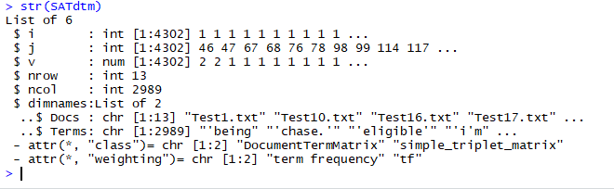
Document Term Matrix - II
Looking at the structure, we see the fields we can access:
dimnames just names the row and column names, which happen to be the document names and words.
CSCI-3907/CSCI-6444 Big Data and Analytics
7-<number>
Notes:
A Document Term matrix (DTM) is one of the most common formats for representing a text corpus (i.e. a collection of texts) in a bag-of-words format.
A DTM is a matrix in which rows are documents, columns are terms, and cells indicate how often each term occurred in each document.
The advantage of this representation is that it allows the data to be analyzed with vector and matrix algebra, effectively moving from text to numbers.
A Term Document Matrix (TDM) is a matrix in which rows are words and columns are documents.
Two ways of showing the same information
But, sometimes, you want to process by words, other times by documents.

Slide 21
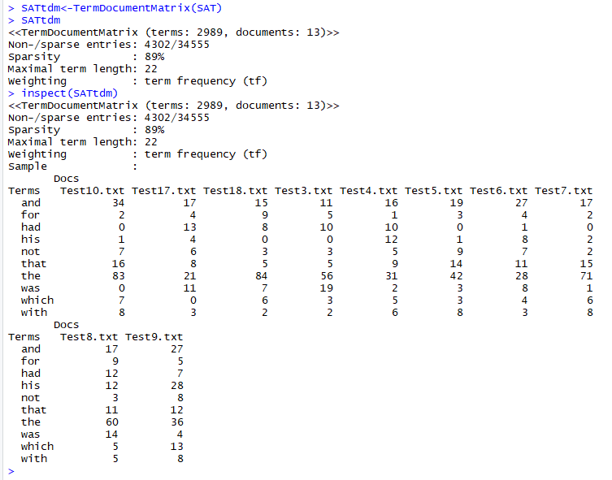
Term Document Matrix (TDM)
Shows word membership in documents.
The obverse mapping of DTM.
CSCI-3907/CSCI-6444 Big Data and Analytics
7-<number>
Notes:
The TDM is just the obverse mapping of the DTM.
Notice sparsity and maximal term length are the same.
This just saves you the trouble of transforming one to the other since both functions are available. And, we may use different representations for different methods.

Slide 22
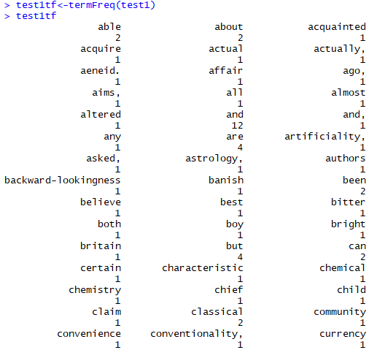
Term Frequency - I
Count the number of occurrences of words in a document
Cannot apply to SAT because it is a corpus.
So, must do each document separately.
CSCI-3907/CSCI-6444 Big Data and Analytics
Notes:
Eventually, we are going to eliminate the words which don’t contribute much information.
These are called “stop words”.
We may see certain terms occurring frequently, especially as we deal:
With very large documents, or
multiple documents on the same topic
These are good indicators for focusing on important aspects of the document(s). They may represent key topics or critical concepts the author(s) emphasize.
However, to determine whether they are important or not, we need a domain ontology to help us understand the domain of the document(s).
However, sometimes, critical information occurs only once in a document.

Slide 23
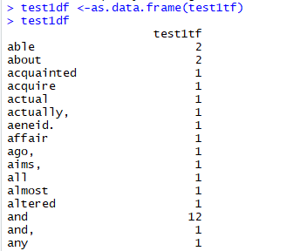
Document Term Frequency - II
Convert to a data frame
Because sometimes we need it represented as a data frame
Because we are most focused on words that convery something about the topics, words such “and”, “the” “a”, and so forth don’t contribute much to our understanding.
In NLP, however, they are very important
and many more words
CSCI-3907/CSCI-6444 Big Data and Analytics
7-<number>
Notes:
As noted, there are words like “and”, “the”, etc. which don’t contribute much to our understanding of topics in Text Analytics.
So, we want to “cleanse” our documents of these words so that we are left with only topic-relevant words.
We also need to remove numbers and punctuations as well. The next few slides show how to do this.

Slide 24

Corpus Cleansing - I
First thing to do is to convert the document to lower case because we are only concerned about the individual words.
Now, let’s remove punctuation using the tm_map function and a function we have written:
CSCI-3907/CSCI-6444 Big Data and Analytics
7-<number>
Notes:
Upper case and lower case are important in NLP
Why?
Well, for one, it helps us to distinguish between the proper name “John” and the word “john” which is British slang (as my daughter tells me) for toilet.
Uppercase indicates proper nouns which are usually the names of people or entities, or titles, such as President.
Note: We discussed the “map” function last week. Here is an example of its use in R.

Slide 25

Corpus Cleansing - II
To remove numbers and punctuation, we do
where SATcl = “clean SAT”
Numbers and punctuation are not terribly useful here, but are very useful in NLP.
Numbers help us to determine amount or time or addresses. We may want to keep them for the latter in certain applications.
Punctuation helps with parsing sentences in text.
CSCI-3907/CSCI-6444 Big Data and Analytics
7-<number>
Notes:
These are examples of Data Cleansing.
Data cleansing is the process of detecting and correcting (or removing) corrupt or inaccurate records from a record set, table, or database and refers to identifying incomplete, incorrect, inaccurate or irrelevant parts of the data and then replacing, modifying, or deleting the dirty or coarse data. (Wikipedia)
It removes major errors and inconsistencies that are inevitable when multiple sources of data are getting pulled into one dataset.
Using tools to cleanup data will make everyone more efficient since they’ll be able to quickly get what they need from the data.
Fewer errors means happier customers and fewer frustrated employees.
The ability to map the different functions and what your data is intended to do and where it is coming from your data.

Slide 26
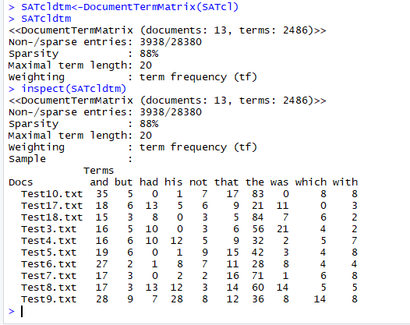
Corpus Cleansing - III
CSCI-3907/CSCI-6444 Big Data and Analytics
7-<number>
Notes:
Some hints on further cleansing:
toSpace <- content_transformer(function (x , pattern ) gsub(pattern, " ", x))
docs <- tm_map(docs, toSpace, "/")
docs <- tm_map(docs, toSpace, "@")
docs <- tm_map(docs, toSpace, "\\|")

Slide 27
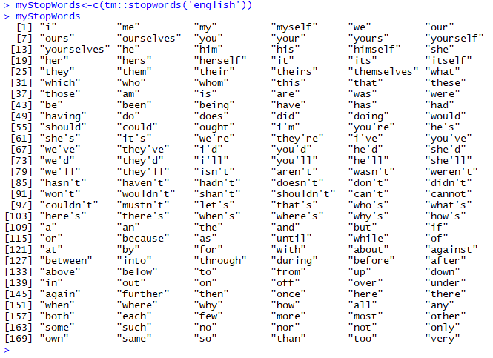
Corpus Cleansing - IV
Stopwords are useful in NLP.
However, we generally eliminate them in text analytics.
You may add additional stop words, separated by commas by using c(…) to bind them to myStopWords
CSCI-3907/CSCI-6444 Big Data and Analytics
7-<number>
Notes:
Stopwords words are so generic that they wouldn’t really help to identify each document. What we really want is a set of words that are unique to each document.
Since we are not doing entity resolution at the semantic level, stopwords do not help us to understand the document.
R has a good set of stop words already defined in English and multiple other languages.

Slide 28
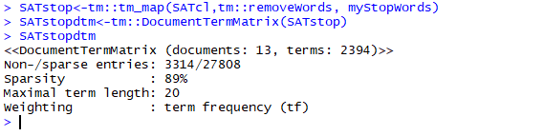
Corpus Cleansing - V
Remove stopwords from the corpus
SATstop is the SAT corpus with no stop words
Compare SATcldtm with SATstopdtm
Note the Maximal Term Length has decreased, also that the non- and sparse entries have decreased.
You may also want to compute SATstoptdm from tm::TermDocumentMatrix
CSCI-3907/CSCI-6444 Big Data and Analytics
Notes:
You can add your own stop words by concatenating them with the variable myStopwords.
There may be some words that are used in documents which you do not want to consider in your analysis.
Do not use a global stop words, but create a variable list for each set of documents that you will process.
Otherwise, you may eliminate words in a document which are really germane to the topic in that document.

Slide 29
Corpus Cleansing - VI
Often, unstructured text contains a lot of noise, especially if you use techniques like web or screen scraping.
  HTML tags are typically one of these components which don’t add much value towards understanding and analyzing text.
You may/should remove html tags.
You should also remove accented characters:
  The comparison between an accented character and a normal character will fail.
Contractions are shortened version of words or syllables.
  They often exist in either written or spoken forms in the English language.
  These shortened versions or contractions of words are created by removing specific letters and sounds.
  In case of English contractions, they are often created by removing one of the vowels from the word.
  Examples would be, do not to don’t and I would to I’d. Converting each contraction to its expanded, original form helps with text standardization.
CSCI-3907/CSCI-6444 Big Data and Analytics
7-<number>
Notes:
Note: we removed these with stop words, so you should expand them before removing stop words.
You may edit the English stop words after you assign them to myStopWords by removing specific words.
For example, you might want to keep the word “not” if you are analyzing phrases within your documents.
Special characters and symbols are usually non-alphanumeric characters or even occasionally numeric characters (depending on the problem), which add to the extra noise in unstructured text. Usually, simple regular expressions (regexes) can be used to remove them.

Slide 30
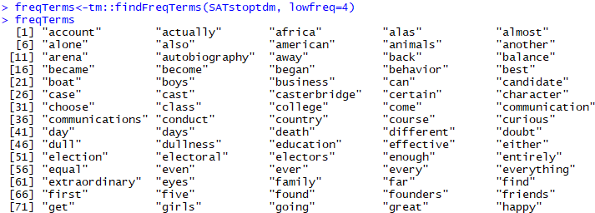
Finding Frequent Words - I
Find terms with a frequency of 4 or more
Most words will have frequency of 1 until you get to a very large collection of documents
Look for meaningful words with large frequency counts.
With the most frequently occurring terms in hand, we can check for correlations between some of these and other terms that occur in the corpus.
Note: There are 149 more than I didn’t print out
CSCI-3907/CSCI-6444 Big Data and Analytics
Notes:
The Document Term Matrix is one way to see the number of occurrences of words in text.
You can also use findFreqTerms and specify a minimum number to find.
Since we eliminated stop words, we are now seeing words related to the topics in the document.
However, you may also identify further stop words. For example, “even”, ”away”, “almost”, “another”.
Here I used 4.
But, when we discuss N-grams, you might see that some of these words as qualifiers for nouns or verbs are useful.

Slide 31
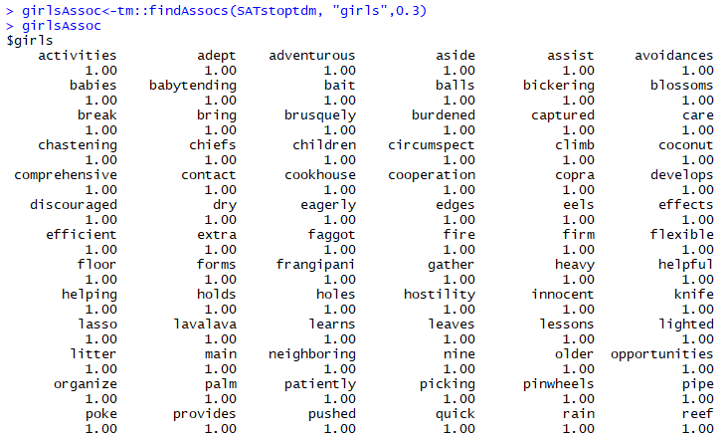
Finding Frequent Words - II
The correlation limit is a lower bound for the strength of correlation between the search and result terms.
  A limit of 1 means that it finds only terms that always co-occur with the search term.
  A measure of the frequency with which the two (search and result term) co-occur in the document(s).
  The correlations throw up interesting combinations of words that may give greater insight into the contents of the document(s).
Lower correlation limit
There are a lot more words!
CSCI-3907/CSCI-6444 Big Data and Analytics
7-<number>
Notes:
You should try different values of the correlation limit, in this case 0.3.

Slide 32
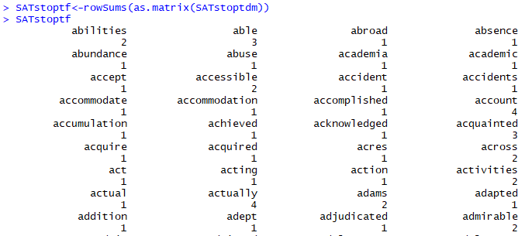
TermFrequency - II
Now, with SATstop
Lot more rows I didn’t print
CSCI-3907/CSCI-6444 Big Data and Analytics
7-<number>
Notes:
A central question in text mining and natural language processing is how to quantify what a document is about.
Can we do this by looking at the words that make up the document?
One measure of how important a word may be is its term frequency (tf), how frequently a word occurs in a document
There are words in a document, however, that occur many times but may not be important. In English, these are probably words like “the”, “is”, “of”, and so forth.
We might take the approach of adding words like these to a list of stop words and removing them before analysis, but it is possible that some of these words might be more important in some documents than others.
A list of stop words is not a very sophisticated approach to adjusting term frequency for commonly used words.

Slide 33
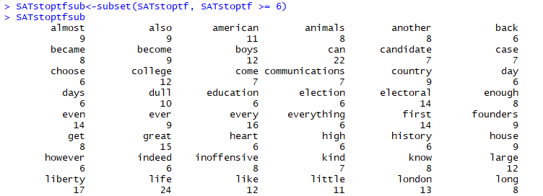
Term Frequency - III
Now, we want to be able to find the words that have more than 6 occurrences (or pick other numbers)
Lots more rows I didn’t print
CSCI-3907/CSCI-6444 Big Data and Analytics
Notes:
term frequency–inverse document frequency, is a numerical statistic that is intended to reflect how important a word is to a document in a collection or corpus.
See tf-idf in Wikipedia
A term’s inverse document frequency (idf), which decreases the weight for commonly used words and increases the weight for words that are not used very often.
The statistic tf-idf is intended to measure how important a word is to a document in a collection (or corpus) of documents in a collection of documents.
NOTE: In the SAT documents, this won’t play much of a role. I am just showing you how to do it.
But, in Project #3, it will be important for you to examine this.

Slide 34
Term Frequency Types
Binary/Boolean:
  tf(term, document) = 1 if term exists, 0 if term does not exist.
  No matter how many times occurs in a document it is still one
  Useful for quick searches to find which documents have which terms.
Term Count:
  How many instances of a term exist in a document?
  Decide which terms are more important.
  Decide which documents are more interesting due to higher counts for given terms.
CSCI-3907/CSCI-6444 Big Data and Analytics
7-<number>
Notes:
Term frequency – inverse document frequency
Building Stopwords
Terms having tf-idf value zero or close to zero can be used in stop-words list.
These are all words that appear in all of the documents, so the idf term is zero.
Important Words
Sort TF-IDF values in descending order.
The terms which appear at top after sorting are the most important words.

Slide 35
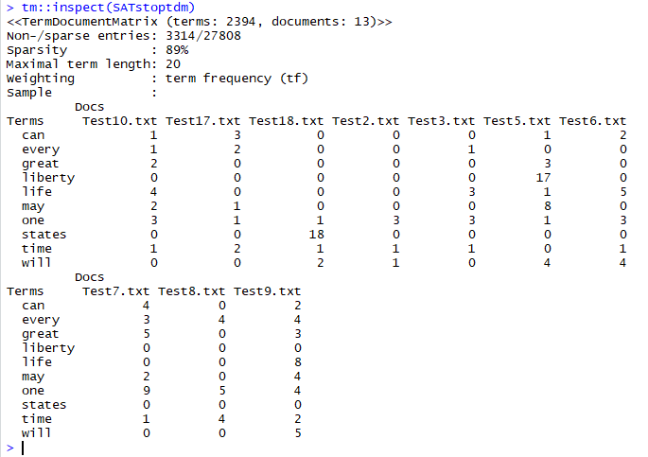
Looking at SATstoptdm again
CSCI-3907/CSCI-6444 Big Data and Analytics
7-<number>
Notes:
We see some words showing up here that we need to consider.
For example, “can” – are we talking about the noun or the verb?
DTM does not distinguish because it does not examine the context in which the word is used.
“Can” as a verb helps to express intent, so we would like to consider that in NLP. For example,
“He can hit a home run if he tries hard” or
“She can throw a triple axel if she gets up enough speed”
However, “can” the noun may be important if we are talking about “oil cans” and automobiles.
Axiom: Context is very important in Natural Language Processing.
Axiom: Without context, you cannot discern intent or other attributes of actors in situations in the text.

Slide 36
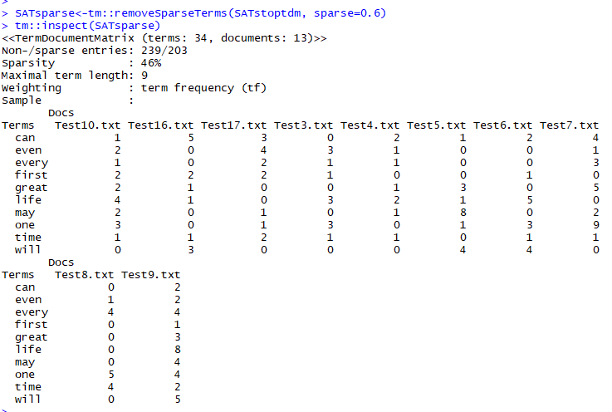
Remove Sparse Terms - I
Wow!! Look at the reduction in sparsity and the maximal term length
CSCI-3907/CSCI-6444 Big Data and Analytics
7-<number>
Notes:
Sparse terms are words that are used rarely in the text – like once or twice.
But, of course, this depends on the size of the text you are processing.
A word used once in a text of a few hundred words is sparse, but so is a word used tens of times in a document having several hundreds of thousands of words.
BEWARE!!! Context is …?
Some sparse words may be the key concepts in a document. Their use in a contextual situation may convey the most important pieces of information.

Slide 37
Remove Sparse Terms – II
But, we have some problems here:
First, we see there are some words like “can”, “may”, “even”, etc. which still occur frequently.
  The question we have to ask is do these contribute anything to understanding the topics.
  There may be “can” as in a “watering can”, but it is hard to differentiate that from the use “can he go to the store”
  Without careful examination of the original text.
Second, we have to determine how much sparsity we want as a means of characterizing the documents.
  There is no heuristic; it is an empirical study.
  Here is where we can use some domain knowledge to decide if specific words really fit the domain or not
CSCI-3907/CSCI-6444 Big Data and Analytics
7-<number>
Notes:
We are beginning to get to the point where we can start thinking about to characterize a corpus.
We may already have a general idea of the domain from the set of documents in the corpus. But, now, need to examine the words that have frequent occurrences to see if they are relevant to the domain.
At the same, we should go back and look at the words that sparsely occur to see if there are key words that can characterize the domain and the documents.

Slide 38
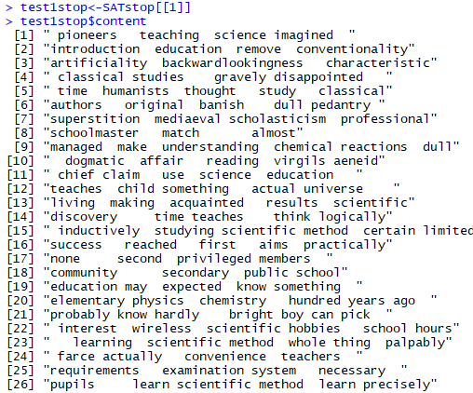
Finding Informative Words
Exercise for students:
Given the list of interesting words in an article, determine how to find the position of each word in the original article.
Then, determine how to computer the distance between each pair of words.
This is distMatrix in the following slides.
CSCI-3907/CSCI-6444 Big Data and Analytics
7-<number>
Notes:
OK, so get document Test1.txt contents, e.g., the cleansed list of words.
Using domain knowledge, select the words that are most relevant to the domain.
You can assign these to a vector via
Test1content<- test1stop$content
Now, if you do this for every document in the corpus, then you can compute the interactions of these two vectors. You can arrange this in a matrix of documents by documents. The diagonal will be 100, but off-diagonal elements will be the # of words overlapping.
Note: the upper right triangle is equal to the lower left triangle.

Slide 39
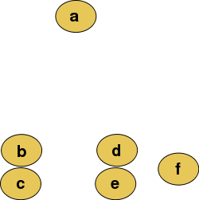
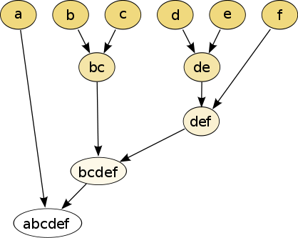
Dendrograms
Given
The top row of nodes represents data (individual observations), and the remaining nodes represent the clusters to which the data belong, with the arrows representing the distance (dissimilarity).
The distance between merged clusters is monotone increasing with the level of the merger: the height of each node in the plot is proportional to the value of the intergroup dissimilarity between its two daughters.
CSCI-3907/CSCI-6444 Big Data and Analytics
7-<number>
Notes:
So, dendrograms are one way to examine the words in a document for clusters of words, e.g. phrases.
Consider the phrase “the all-time home run king is ….”
This tells us a lot in a few words: the domain, at least one topic, and one man stands out above the res historically.

Slide 40
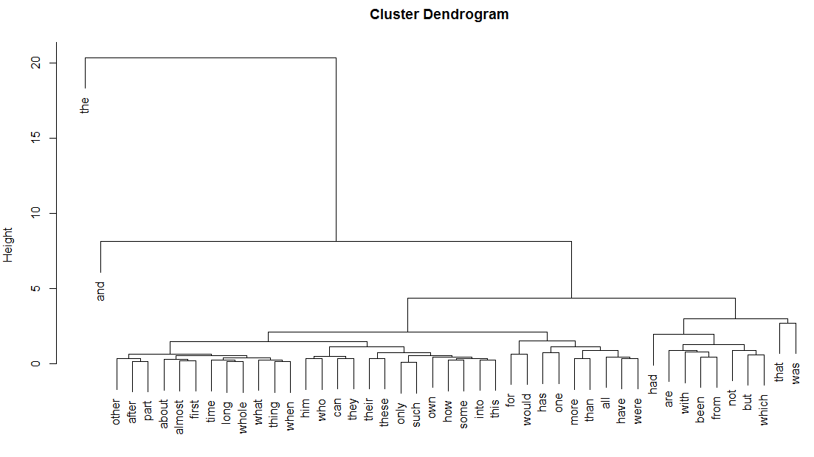
Clustering Terms via Dendrogram
A dendrogram is a tree diagram frequently used to illustrate the arrangement of the clusters produced by hierarchical clustering
CSCI-3907/CSCI-6444 Big Data and Analytics
Notes:
Oooops! I did this one before I removed the stop words.

Slide 41
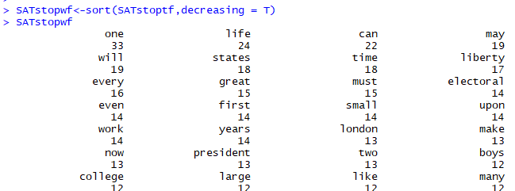
Word Cloud - I
A word cloud can assist in visualizing the most frequently used words in a text.
  The height of each word in the visualization is an indication of frequency word in the entire text.
Word clouds add simplicity and clarity. The most used keywords stand out better in a word cloud
Word clouds are a potent communication tool. They are easy to understand, to be shared and are impactful
Word clouds are visually engaging than a table data
CSCI-3907/CSCI-6444 Big Data and Analytics
Notes:
You have seen these, for example, in Wikipedia, but in many other areas as well.
Visually, it helps us to focus on important words. The eye-brain combination recognizes information faster when it is presented as a picture.

Slide 42
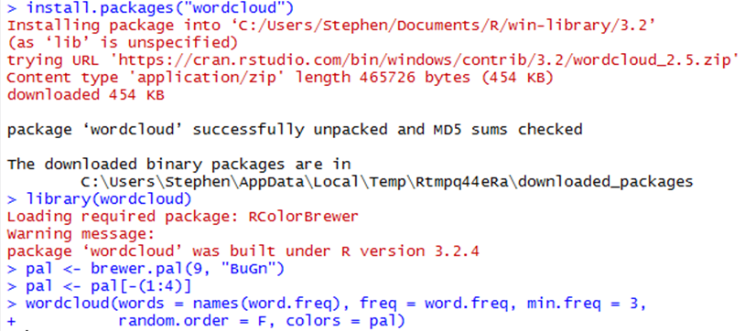
Word Cloud - II
CSCI-3907/CSCI-6444 Big Data and Analytics
7-<number>
Notes:
Word frequency visualizations are fun, and can be a quick way to give an overview of what your respondents are talking about. They also can reveal some surprises in the data that prompt further investigation.

Slide 43
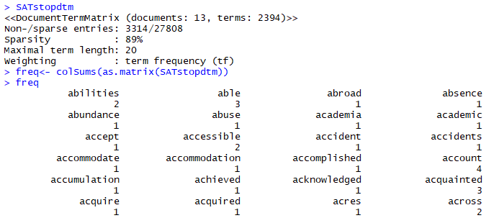
Frequency Analysis - I
We have converted a corpus of text into a mathematical object that can be analyzed using quantitative techniques of matrix algebra.
It should be no surprise, therefore, that the DTM is the starting point for quantitative text analysis.
CSCI-3907/CSCI-6444 Big Data and Analytics
7-<number>
Notes:
Frequency analysis, when applied to individual characters, is often useful in cryptographic analysis.
Frequency analysis of words has been applied for over two centuries. For example, to the Bible, to Shakespeare’s plays and sonnets, and even Champollion’s work in deciphering hieroglyphics.
We can use word frequency to classify documents, to build taxonomies, and to help populate ontologies.
So, some words can be eliminated if they are sparsely used in text analytics and are common words, such as “can” and “one”
But, when we do phrase analysis and then move on to NLP, they can become important to qualifying the concept(s) we are considering.

Slide 44
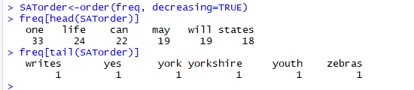
Frequency Analysis - II
Sort freq in descending order
And, list the most and least frequently occurring terms
The least frequent terms can be more interesting than one might think. This is because terms that occur rarely are likely to be more descriptive of specific documents.
Words like “can” and “one” give us no information about the subject matter of the documents in which they occur. They can therefore be eliminated without loss in text analytics. Indeed, they ought to have been eliminated by the stopword removal we did earlier. However, since such words occur very frequently – virtually in all documents – we can remove them by enforcing bounds when creating the DTM
CSCI-3907/CSCI-6444 Big Data and Analytics
7-<number>
Notes:
Limitations:
There is no weighting or significance: Since word frequency tools just count the occurrence of each word (one point for each utterance) they really only show one thing: how often a word was said. This sounds obvious, but it doesn't give any indication of how important the use of a word was for each event.
Derivations don't get counted together: 'fish', 'fishy' and 'fishes' will all get counted as separate words (as will any typos or mis-spellings). This might not sound important, but if you are trying to draw conclusions, you could miss the importance of fish to your participants.
They won't amalgamate different terms used by participants: It's fascinating how different people have their own terms and language to describe the same thing, and illuminating this can bring color to qualitative data or show important subtle differences that are important for IPA[[]] or discourse analysis. But when doing any kind of word count analysis, this richness is a problem – as the words are counted separately. Thus neither term 'shiny', 'bright' or 'blinding' may show up often, but if grouped together they could show a significant theme.

Slide 45
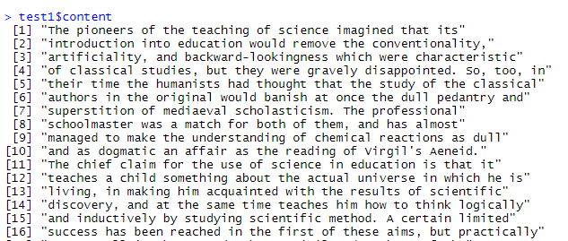
Text Analysis: Tokenization - I
install.packages(“quanteda”)
Let’s use test1$content
Tokenization is the process of splitting a text into tokens.
Most often tokens are words, because these are the most common semantically meaningful components of texts.
CSCI-3907/CSCI-6444 Big Data and Analytics
7-<number>
Notes:
Tokenization is the process of demarcating and possibly classifying sections of a string of input characters. The resulting tokens are then passed on to some other form of processing. The process can be considered a sub-task of parsing input.
In phrase analysis, we might to consider our tokens to be groups of words.
The size of a phrase can vary. It might be two words, it might 6 or 7 or 8 words (or more).
Phrases are important. They convey a single concept.
They may be noun phrases or verb phrases. Noun phrases include adjectives and prepositional phrases. Verb phrases include adverbs and prepositional phrases.

Slide 46
Text Analysis: Tokenization - II
For many languages, splitting texts by words can mostly be done with low-level string processing due to clear indicators of word boundaries, such as white spaces, dots and commas.
A good tokenizer, however, must also be able to handle certain exceptions, such as the period in the title “Dr.”, which can be confused for a sentence boundary.
Furthermore, tokenization is more difficult for languages where words are not clearly separated by white spaces, such as Chinese and Japanese.
To deal with these cases, some tokenizers include dictionaries of patterns for splitting texts.
In R, the stringi package is often used for sentence and word disambiguation, for which it leverages dictionaries from the ICU library.
Here we will use quanteda’s tokens function to split a single sentence into words.
The tokens function returns a list whose elements each contain the tokens of the input texts as a character vector.
CSCI-3907/CSCI-6444 Big Data and Analytics
7-<number>
Notes:
Re: Bullet 2. Usually, it is a good idea as part of the preprocessing of text to expand all abbreviations and acronyms.
So, “Dr.” would be expanded to “Doctor” and “U.S.” would be expanded to “United States”
And, in some languages,, a symbol may convey a phrase rather than just a word.

Slide 47
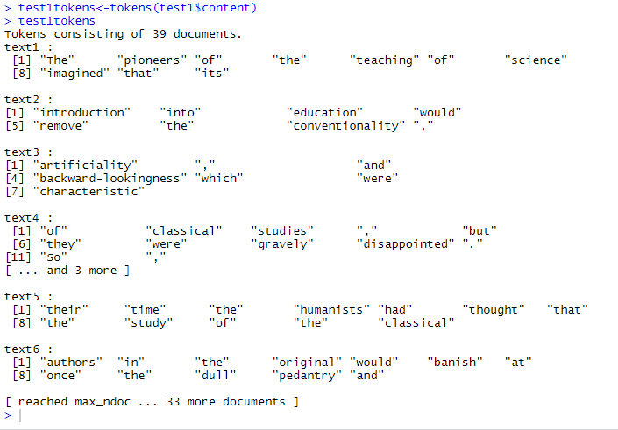
Text Analysis: Tokenization – III
Extract the tokens
CSCI-3907/CSCI-6444 Big Data and Analytics
7-<number>
Notes:
Construct a list of tokens per line of text using quanteda’s tokenizer.
Tokens are the individual units of meaning you're operating on.
In text analytics, tokens are most frequently just words.
Tokenization is the process of breaking apart a sentence or phrase into its component pieces. Tokens are usually words or numbers. Depending on the type of unstructured text you’re processing, however, tokens can also be:
Punctuation (exclamation points amplify sentiment)
Hyperlinks (https://…)
Possessive markers (apostrophes)
Tokenization is language-specific, so it’s important to know which language you’re analyzing. Most alphabetic languages use whitespace and punctuation to denote tokens within a phrase or sentence.
Logographic (character-based) languages such as Chinese, however, use other systems.

Slide 48
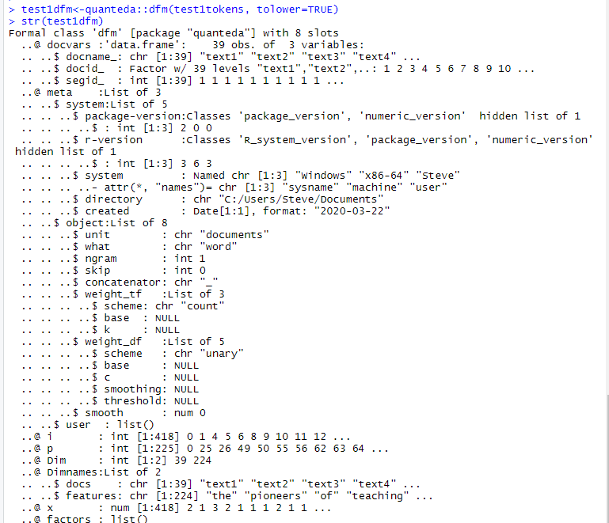
Text Analysis: Tokenization – IV
Read the description of dfm in quanteda.
Apply dfm to test1tokens.
A Document Feature Matrix (DFM) has documents in rows and features in columns.
Since we did this to a corpus, the docs are the names of the lines; the features are the tokens in each line.
Compare this to the output of the tokenizer.
And, read the documentation.
CSCI-3907/CSCI-6444 Big Data and Analytics
7-<number>
Notes:
This is the structure of the result from dfm(…).
You can also obtain the names of documents and features by docnames() and featnames().
The most frequent features can be found using topfeatures().
See https://tutorials.quanteda.io/

Slide 49
Text Weighting - I
Not all terms are equally informative for text analysis. One way to deal with this is to remove these terms from the DTM.
A simple but effective method is to filter on document frequencies (the number of documents in which a term occurs), using a threshold for minimum and maximum number (or proportion) of documents.
Instead of removing less informative terms, an alternative approach is o assign them variable weights.
Many text analysis techniques perform better if terms are weighted to take an estimated information value into account, rather than directly using their occurrence frequency.
A popular weighting scheme that does so is term frequency-inverse document frequency (tf-idf), which down-weights words that occur in many documents in the corpus.
See the quanteda documentation!
CSCI-3907/CSCI-6444 Big Data and Analytics
7-<number>
Notes:
We use text weighting in searches of large corpuses to find the (most) relevant texts to our interests.
The most common weighting method is “term frequency-inverse document frequency”.
Down-weighing reduces the weight assigned to words if they occur frequently.
While the same words occurring in many documents can “tie” the set of documents together relative to a domain, they would not be useful when searching for specific documents.

Slide 50
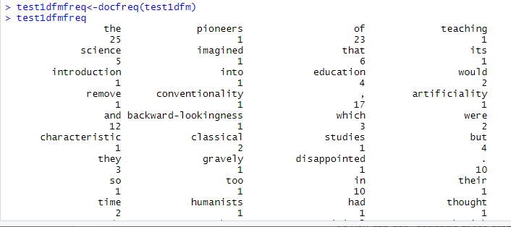
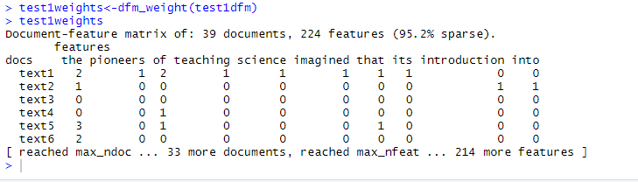
Text Weighting - II
CSCI-3907/CSCI-6444 Big Data and Analytics
7-<number>
Notes:
So, docfreq looks at the frequency of occurrence of words in a single document.
Weight the feature frequencies in a dfm
Weights are per line

Slide 51
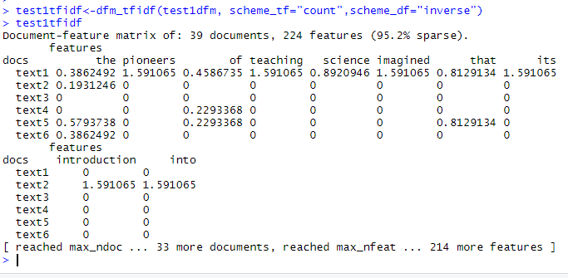
Text Weighting - III
Compute tf-idf score for each line
CSCI-3907/CSCI-6444 Big Data and Analytics
7-<number>
Notes:
Quanteda provides an implementation of tf-idf with several parameters (see the documentation).

Slide 52
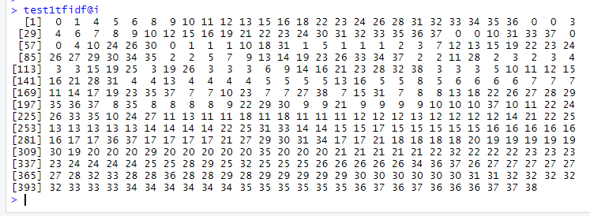
Text Weighting - IV
SATtfidf is an S4 class (one of several in R)
To access slots , look at STR, then use the ‘@’operator
See quanteda documentation
See “A (not so) Short Introduction to S4” by Christophe Genolini
This is on Blackboard
CSCI-3907/CSCI-6444 Big Data and Analytics
7-<number>
Notes:
This is where problems arise.
Quanteda produces the results in a different structural representation, S4, which is not compatible (not a superset-of) other structure representations, such as S3 – even though it may appear that way.
Contributions to the Consolidated Repository are produced by many different authors with their own interests in mind. So, using packages from the repository often requires some detective work to figure out how they work in order to make them useful.

Slide 53
Sentiment Analysis - I
Two types of data on the Web:
  Facts: expressed w/ topic keywords
  Opinions: hard to express with a few words; emotional content
Search engines do not search for opinions
Understand what customers are saying about products, services, etc.
  Early warning of issues
  Manage brand perception
  Sales lead generation
  Product design insight
  And more ….
CSCI-3907/CSCI-6444 Big Data and Analytics
7-<number>
Notes:
Sentiment Analysis is a process of extracting opinions that have different polarities. By polarities, we mean positive, negative or neutral. It is also known as opinion mining and polarity detection.
With the help of sentiment analysis, you can find out the nature of opinion that is reflected in documents, websites, social media feed, etc.
Sentiment Analysis is a type of classification where the data is classified into different classes. These classes can be binary in nature (positive or negative) or, they can have multiple classes (happy, sad, angry, etc.).

Slide 54
Sentiment Analysis - II
Direct Opinions: sentiment expressions about some object or event or person:
  “The picture on this camera is great!”
Comparisons: relations expressing similarities or differences of more than one object, event, or person:
  “Some say a Lamborghini is a nicer car than a Mustang”
There are lots and lots of opinions on the Web:
  Blogs, surveys, advertisements, Fake News (the Fox News kind), lies, etc.
Opinions are important in making decisions in everyday life.
  Asking friends about a movie, a restaurant, or (Gasp!!) a professor.
CSCI-3907/CSCI-6444 Big Data and Analytics
7-<number>
Notes:
Emotion detection
This type of sentiment analysis aims at detecting emotions, like happiness, frustration, anger, sadness, and so on. Many emotion detection systems use lexicons (i.e. lists of words and the emotions they convey) or complex machine learning algorithms.
One of the downsides of using lexicons is that people express emotions in different ways. Some words that typically express anger, like bad or kill (e.g. your product is so bad or your customer support is killing me) might also express happiness (e.g. this is bad ass or you are killing it).
Aspect-based Sentiment Analysis
Usually, when analyzing sentiments of texts, let’s say product reviews, you’ll want to know which particular aspects or features people are mentioning in a positive, neutral, or negative way. That's where aspect-based sentiment analysis can help, for example in this text: "The battery life of this camera is too short", an aspect-based classifier would be able to determine that the sentence expresses a negative opinion about the feature battery life.
Multilingual sentiment analysis
Multilingual sentiment analysis can be difficult. It involves a lot of preprocessing and resources. Most of these resources are available online (e.g. sentiment lexicons), while others need to be created (e.g. translated corpora or noise detection algorithms), but you’ll need to know how to code to use them.

Slide 55
Sentiment Analysis - III
Sentiment Analysis:
  Determine if a sentence is expressing a positive/neutral/negative sentiment (Opinion) about some object, event, or person.
Assess sentiment at various linguistic levels:
  Words: objective, subjective, positive, negative, neutral
  Clauses: “I am going crazy over <favorite person>”
  Sentences – possibly multiple sentiments
  Documents – possibly many sentiments on various topics
To assess sentiment at the sentence level, you should consider sentence structure
  Need an algebra for combining sentiments into a single value
  May be binary or multivalued
  Possibly represent sentiment as a vector
CSCI-3907/CSCI-6444 Big Data and Analytics
7-<number>
Notes:
Sorting Data at Scale
Can you imagine manually sorting through thousands of tweets, customer support conversations, or surveys? There’s just too much business data to process manually. Sentiment analysis helps businesses process huge amounts of data in an efficient and cost-effective way.
Real-Time Analysis
Sentiment analysis can identify critical issues in real-time, for example is a PR crisis on social media escalating? Is an angry customer about to churn? Sentiment analysis models can help you immediately identify these kinds of situations, so you can take action right away.
Consistent criteria
It’s estimated that people only agree around 60-65% of the time when determining the sentiment of a particular text. Tagging text by sentiment is highly subjective, influenced by personal experiences, thoughts, and beliefs. By using a centralized sentiment analysis system, companies can apply the same criteria to all of their data, helping them improve accuracy and gain better insights.

Slide 56
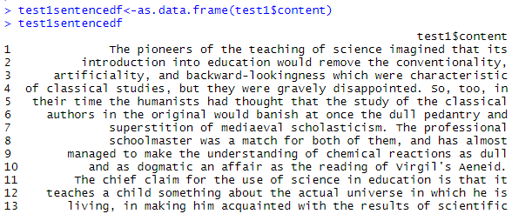
Text Analysis: Sentiment Analysis - IV
install.packages(“syuzhet”)
library(syuzhet)
“syuzhet” uses the NRC Emotion lexicon.
  The NRC emotion lexicon is a list of words and their associations with eight emotions (anger, fear, anticipation, trust, surprise, sadness, joy, and disgust) and two sentiments (negative and positive).
Convert test1$content to a data frame
Partial
listing
CSCI-3907/CSCI-6444 Big Data and Analytics
7-<number>
Notes:
View(nrc) to see all the words and what emotion they are considered, or the other dataframes for the +/- valence
See also on using Syuzhet: https://www.youtube.com/watch?v=kaqo9JA0u5o

Slide 57
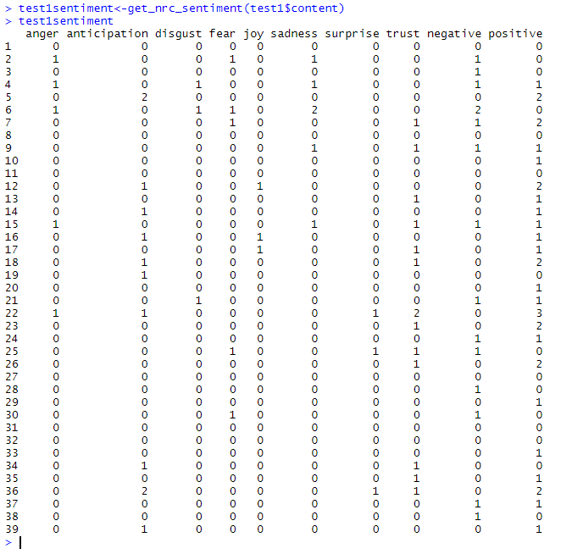
Text Analysis: Sentiment Analysis - V
Calls the NRC sentiment dictionary to calculate the presence of eight different emotions and their corresponding valence in a text file.
A data frame where each row represents a sentence from the original file. The columns include one for each emotion type as well as a positive or negative valence.
See http://saifmohammad.com/WebPages/lexicons.html
CSCI-3907/CSCI-6444 Big Data and Analytics
7-<number>
Notes:
So, we see the sentiment produced by the syuzhet:get_nrc_sent in 10 categories.
A good sentiment analysis system may have more, but that is dependent on the developer and the program used.

Slide 58
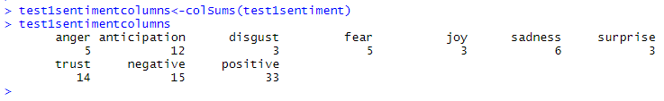
Text Analysis: Sentiment Analysis - VI
Row sums over test1sentiment shows the number of sentiments expressed in that sentence.
Column sums over test1sentiment shows the total number of each type of sentiment or emotion in the document.
Using data for each document, you can characterize the corpus according to sentiment and emotions.
CSCI-3907/CSCI-6444 Big Data and Analytics
7-<number>
Notes:
Irony and Sarcasm
When it comes to irony and sarcasm, people express their negative sentiments using positive words, which can be difficult for machines to detect without having a thorough understanding of the context of the situation in which a feeling was expressed.
For example, look at some possible answers to the question, Did you enjoy your shopping experience with us?
Yeah, sure. So smooth!
Not one, but many!
What sentiment would you assign to the responses above? The first response with an exclamation mark could be negative, right? The problem is there is no textual cue that will help a machine learn, or at least question that sentiment since yeah and sure often belong to positive or neutral texts.
How about the second response? In this context, sentiment is positive, but we’re sure you can come up with many different contexts in which the same response can express negative sentiment.
Defining Neutral
Defining what we mean by neutral is another challenge to tackle in order to perform accurate sentiment analysis. As in all classification problems, defining your categories -and, in this case, the neutral tag- is one of the most important parts of the problem. What you mean by neutral, positive, or negative does matter when you train sentiment analysis models. Since tagging data requires that tagging criteria be consistent, a good definition of the problem is a must.

Slide 59
Beyond Simple Sentiment Analysis
Beyond Good and Evil (positive and negative)
  Degrees of intensity, complexity of emotions and documents
  Need really good sentiment dictionary
Importance of Context – around positive and negative words
  Rhetorical reversals – “I was expecting to love it”
  Issues of sarcasm, (“Really Great Product”), “slang”uage
Essential – need full categorization and concept extraction
New Taxonomies – Appraisal Groups – “not very good”
  Supports more subtle distinctions than positive or negative
Emotion taxonomies - Joy, Sadness, Fear, Anger, Surprise, Disgust
  New Complex – pride, shame, confusion, skepticism
New conceptual models of users and communities:
  Domain-based
  Robust and backed up by data and relationships
CSCI-3907/CSCI-6444 Big Data and Analytics
7-<number>
Notes:
Subjectivity and Tone
There are two types of text: subjective and objective. Objective texts do not contain explicit sentiments, whereas subjective texts do. Say, for example, you intend to analyze the sentiment of the following two texts:
The package is nice.
The package is red.
Most people would say that sentiment is positive for the first one and neutral for the second one, right? All predicates (adjectives, verbs, and some nouns) should not be treated the same with respect to how they create sentiment. In the examples above, nice is more subjective than red.
Context and Polarity
All utterances are uttered at some point in time, in some place, by and to some people, you get the point. All utterances are uttered in context. Analyzing sentiment without context gets pretty difficult. However, machines cannot learn about contexts if they are not mentioned explicitly. One of the problems that arise from context is changes in polarity. Look at the following responses to a survey:
Everything of it.
Absolutely nothing!
Imagine the responses above come from answers to the question What did you like about the event? The first response would be positive and the second one would be negative, right? Now, imagine the responses come from answers to the question What did you Dislike about the event? The negative in the question will make sentiment analysis change altogether.

Slide 60
Text Analytics: Benefits - I
Enterprise Content Management:
  Search methods of unstructured text have failed to yield insights
    Search engines are stupid – syntactic comparison
    Do not have understanding of the content
    For multiterm search, no understanding of relationships
  Need to cluster and classify documents according to many criteria.
    Text Analytics extracts terms that can be used for clustering and classification.
    Text Analytics can relate terms to one another to enhance categorization.
    Text Analytics can help to develop – with external ontological assistance – taxonomies of documents over multiple dimensions.
CSCI-3907/CSCI-6444 Big Data and Analytics
7-<number>
Notes:
Syntactic comparison – as used by many statistical methods – does not “know” the meaning of words.
Such methods are based on frequency of occurrence and other statistical measures.
See Wikipedia articles on statistical NLP.

Slide 61
Text Analytics: Benefits - II
What is the ROI (Return on Investment)?
Resources Required:
  Skilled People – expensive
  Volume of documents to be (re)processed – time
  Hardware – Cloud or In-house?
  Software – buy, contract out, build your own
How do you evaluate the benefits?
  Time to decision
  Enabling better/faster search on large repositories
  Continuous improvement
Issues:
  Senior Management Buy-in
  Computing and believing the ROI numbers
  Lack of knowledge about text analytics
  Complex processes
CSCI-3907/CSCI-6444 Big Data and Analytics
7-<number>
Notes:
This is the tough part!
Return on Investment:
What do I get out of it?
When do I get it?
How much does it exceed my investment?
As a gut feeling, was it worth it?

Slide 62
Text Analytics: Why is it tough?
Text Analytics is weird, a bit academic, and not very practical at first blush
  It involves language and thinking and math/statistics and …
It is really difficult to do right (may be Rocket Science)
Getting data extraction right – reliable, accurate, precise is tough
  See next lecture
Organizations don’t know what text analytics is and what it is for
False Model – all you need is our software and your Subject Matter Experts (SMEs)
  Categorization is not a skill that SME’s have
  Rule Building is more esoteric – part library science, part business analysis, part cognitive science
  Using ontologies and building taxonomies is hard
CSCI-3907/CSCI-6444 Big Data and Analytics
7-<number>
Notes:
Despite the claimed successes in neural NLP and the use of deep learning techniques, bullet 2 still strongly applies.
Note: both symbolic and neural NLP systems require lots of domain knowledge to do a passable job in handling NLP.
Natural Language Understanding is considered an AI-hard problem.
Often – as humans – we have trouble what other people are saying. Consider how much harder it is to get a machine to do it when it does not have the domain knowledge and consciousness we have.
In verbal conversations – face to face – we often rely on other physical and physiological cues to help us understand what is being said.
And, then there are idioms, metaphors, jargon, acronyms, abbreviations, etc. to make it even more difficult.
Beware the vendors hyping products!

Slide 63
N-Grams - I
An N-gram finds n words in sequence in a text.
A set of co-occurring words within a given window.
  N-gram of size 1 - unigram
  N-gram of size 2 - bigram
  N-gram of size 3 - trigram
When N >= 2, the idea is to find phrases that have a “greater” meaning than just the individual words.
  For example, “North Korea” or “greatest fighter”
Phrases often form idioms which have a different meaning than that of the individual words.
If X=Num of words in a given sentence K, the number of n-grams for sentence K would be:
CSCI-3907/CSCI-6444 Big Data and Analytics
Notes:
Now if we assign a probability to the occurrence of an N-gram or the probability of a word occurring next in a sequence of words, it can be very useful. Why?
First of all, it can help in deciding which N-grams can be chunked together to form single entities (like “San Francisco” chunked together as one word, “high school” being chunked as one word).
It can also help make next word predictions. Say you have the partial sentence “Please hand over your”. Then it is more likely that the next word is going to be “test” or “assignment” or “paper” than the next word being “school”.
It can also help to make spelling error corrections. For instance, the sentence “drink cofee” could be corrected to “drink coffee” if you knew that the word “coffee” had a high probability of occurrence after the word “drink” and also the overlap of letters between “cofee” and “coffee” is high.

Slide 64
N-Grams - II
For Example, for the sentence "The cow jumps over the moon".
  If N=2 (known as bigrams), then the n-grams would be:
  the cow, cow jumps, jumps over, over the, the moon
  If N=3 (trigram), the n-grams would be:
  the cow jumps, cow jumps over, jumps over the, over the moon
Often N-grams are used to characterize the feature space of the document.
However, some research papers say N-grams may not yield any improvement in understanding the feature space.
CSCI-3907/CSCI-6444 Big Data and Analytics
7-<number>
Notes:
We can build with it: that’s the N-gram model.
Basically, an N-gram model predicts the occurrence of a word based on the occurrence of its N – 1 previous words.
So here we are answering the question – how far back in the history of a sequence of words should we go to predict the next word?
For instance, a bigram model (N = 2) predicts the occurrence of a word given only its previous word (as N – 1 = 1 in this case).
Similarly, a trigram model (N = 3) predicts the occurrence of a word based on its previous two words (as N – 1 = 2 in this case).

Slide 65

N-Grams - III
Consider a very small sample of sentences, but in reality, a corpus should be extremely large.
Say our corpus contains the following sentences:
  He said thank you.
  He said bye as he walked through the door.
  He went to San Diego.
  San Diego has nice weather.
  It is raining in San Francisco.
The probability is (the number of times the previous word ‘wp’ occurs before the word ‘wn’) / (the total number of times the previous word ‘wp’ occurs in the corpus)
(Count (wp wn))/(Count (wp))
So, to find the probability of the word “you” following the word “thank”, we can write this as P (you | thank) which is a conditional probability.
We can say that it is likely whenever “Thank” occurs, it will be followed by “You”
in this corpus.
CSCI-3907/CSCI-6444 Big Data and Analytics
7-<number>
Notes:
So, given a corpus, we can predict from the data the occurrence of words in N-grams.
Why is this useful?
If parts of the text are missing or obscured, if we assume the text follows a particular writer’s model/style of writing, then we can possibly fill in some of the gaps.
If we have several documents written by the same author, we can develop N-grams of interest for one document and use them to search the others.
If we have several documents – one known to have been written by a certain author, say Shakespeare, find unique N-grams and search the others for them. Build a model to argue that some of the other documents could also have been written by Shakespeare.

Slide 66
Unigram Representation
The founder of Pakistan's nuclear program, Abdul Qadeer Khan, has admitted he transferred nuclear technology to Iran, Libya and North Korea, a Pakistani government official said Monday.
Khan made the confession in a written statement submitted "a couple of days ago" to investigators probing allegations of nuclear proliferation by Pakistan, the official told The Associated Press on condition on anonymity.
The transfers were made during the late 1980s and in the early and mid 1990s, and were motivated by "personal greed and ambition," the official said.
The official said the transfers were not authorized by the government.
Word | # in Document
Khan | 15
nuclear | 14
Pakistan | 10
transfers | 9
official | 8
scientists | 5
journalists | 5
government | 5
Libya | 5
officials | 4
military | 4
…
CSCI-3907/CSCI-6444 Big Data and Analytics
Notes:
When we look at individual words, some of them may convey some idea of what the document is about.
But, a bag of words can often convey just about any topic with a little imagination.
It is the breadth and depth of the analyst’s experience that helps them to identify possible domains based on a bag of words.

Slide 67
Bigram Representation
The founder of Pakistan's nuclear program, Abdul Qadeer Khan, has admitted he transferred nuclear technology to Iran, Libya and North Korea, a Pakistani government official said Monday.
Khan made the confession in a written statement submitted "a couple of days ago" to investigators probing allegations of nuclear proliferation by Pakistan, the official told The Associated Press on condition on anonymity.
The transfers were made during the late 1980s and in the early and mid 1990s, and were motivated by "personal greed and ambition," the official said.
The official said the transfers were not authorized by the government.
Bigram | # in Document
North Korea | 4
nuclear transfers | 3
Government official | 3
Pakistan’s nuclear | 3
written statement | 2
told investigators | 2
other suspects | 2
other Muslim | 2
nuclear program | 2
nuclear powers | 2
military officials | 2
become nuclear | 2
CSCI-3907/CSCI-6444 Big Data and Analytics
Notes:
Finding co-occurring words with high frequency and high probability gives us a better understanding of the topic of a document.
Look at the bigrams above
Does it tell you a lot about what these few paragraphs were about?
Using bigrams can help narrow down the number of topics in a document.
Using trigrams can further clarify the topics.
Beyond that, you are into the realm of NLP (my thought).

Slide 68
Syntactic Representation
The
founder
of
Pakistan’s
nuclear department
Abdul Qadeer Khan
has
admitted
he
transferred
nuclear technology
to
Iran,
Libya,
and
North Korea
NP
NP
NP
PP
S
NP
NP
VP
VP
SBAR
S
NP
VP
NP
PP
TreeBank includes
Part of speech
Syntactic structure
NP
NP
NP
NP
CSCI-3907/CSCI-6444 Big Data and Analytics
Notes:
As we will see in the next lecture, tagging words with parts of speech helps us to understand their importance in a document and helps us to – eventually – construct a set of knowledge frames which can be used to update databases.
This is a preparatory stage to parsing sentences for validity in NLP.
Penn TreeBank was and is a useful set of rules for assigning parts of speech. In my NLP work, I have added a few additional tags and their associated rules to improve the tagging of words.
“Adjective, superlative|JJS
Adjectives with the superlative ending -est (as well as worst) are tagged as JJS. Most and least when used as adjectives, as in the most or the least mail, are also tagged as JJS. Most and least can also be tagged as JJS when they occur by themselves; see the entries for these words in Section 4.2.
Adjectives with a superlative meaning but without the superlative ending -est, like first, last or unsurpassed, should simply be tagged as JJ.”
Stay tuned next week for the NLP Lecture.

Slide 69
Discussion Questions
Can you think of some examples that you experience today where text analytics is being used?
Given what you read about Sentiment Analysis, how accurate do you think it is?
CSCI-3907/CSCI-6444 Big Data and Analytics
7-<number>

Slide 70
Resources - I
Griffith, E. (2018, November 15). 90 percent of the big data we generate is an unstructured mess. Retrieved from PC Magazine: https://www.pcmag.com/news/364954/90-percent-of-the-big-data-we-generate-is-an-unstructured-me
Luellen, E. 2019. An Updated Text Analytics Primer: Key Factors in a Text Analytics Strategy, https://towardsdatascience.com/a-text-analytics-primer-key-factors-in-a-text-analytics-strategy-d24dc84a5576
Miner, G., Delen, D., Elder, J., Fast, A., Hill, T., Nisbet, R. (2012). The seven practice areas of text analytics. In Practical text mining and statistical analysis for non-structured text data applications (pp. 29–41). Amsterdam: Elsevier, Inc.
CSCI-3907/CSCI-6444 Big Data and Analytics
7-<number>

Slide 71
Resources - II
Lakoff, G. 1980 with Mark Johnson. Metaphors We Live By. University of Chicago Press.
Lakoff, G. 1987. Women, Fire, and Dangerous Things: What Categories Reveal About the Mind. University of Chicago Press.
Pinker, S. 1997. How the Mind Works
Pinker, S. 2000. Words and Rules: The Ingredients of Language
Kahneman, D. 2011. Thinking, Fast and Slow, Farrar, Straus and Giroux
Fora:
  http://www.textanalyticsforum.com
  http://www.dataversity.net/
  www.sentimentsymposium.com
CSCI-3907/CSCI-6444 Big Data and Analytics
7-<number>

